Slide 1

UNIVERSITY INSTITUTE OF COMPUTING
Agile Methodology
(24CAT-656)

Slide 2
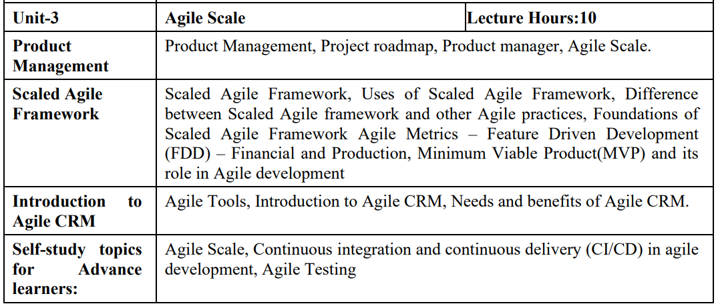
SYLLABUS
2

Slide 3
CONTENT OF THE SYLLABUS
TEXT BOOKS
T1 David J. Anderson and Eli Schragenheim, Agile Management for Software Engineering: Applying the Theory of Constraints for Business Results, Prentice Hall, 2003.
T2 Hazza and Dubinsky, Agile Software Engineering, Series: Undergraduate Topics in Computer Science, Springer, 2009.
T3 Agile Software Development Ecosystems by Jim Highsmith, Addison-Wesley 2002, ISBN 0201760436.
REFERENCES
R1 Craig Larman, Agile and Iterative Development: A Managers Guide, Addison-Wesley, 2004.
R2 Kevin C. Desouza, Agile Information Systems: Conceptualization, Construction, and Management, Butterworth-Heinemann, 2007.
3

Slide 4
Foundation of Scale Agile Framework
Your company is planning an agile transformation? It plans to scale agile methods across teams – or has it already done so? Everyone talks about the different levels and configuration options in the context of, for example, scaled agile frameworks such as SAFe®? Yes, these terms are not that easy to understand.
4

Slide 5
What are the three levels of the scaled agile framework?
In order to be able to scale agile methods, the (SAFe®) has different so-called levels.
To make it short, the 3 levels of scaled agile framework are team level, program level and portfolio level.
So within the scaled agile framework the level above team is program level, then comes portfolio level.
5

Slide 6
It has to be added that since the latest version of SAFe® 5.0, 3 levels of scaled agile framework are not enough anymore - another fourth level has been added. So the question that we should rather ask is, what are the four levels of the scaled agile framework?
Before we go any deeper, a quick note. We recently had 11 international senior agile practitioners as guests in one of our webinars, asking one question: How do you scale agile methods the right way?
The result of this is the following fantastic video recording that answers some of the key questions when scaling agile, for example:
Should you start your agile transformation rather bottom-up or top-down?
How do you align leadership on a common goal and vision?
How do you choose the right agile framework – and why is that actually not that important?
6

Slide 7
hat are the four levels of the scaled agile framework?
The four levels of the scaled agile framework are team level, program level, portfolio level and also include the large solution level. Now let us get a little deeper.
Scaled Agile Framework Level 1: Team Level One or a few teams working on something. Within the scaled agile framework the level above team level is…
Scaled Agile Framework Level 2: Program level The Program Level contains many teams to deliver solutions via a so-called “Agile Release Train” (ART). An Agile Release Train (ART) is typically a number of 50 to 130 people - organized in sub-teams - working together to deliver value. An Agile Release Train is organized by so-called “teams-of-teams”.
7

Slide 8
Scaled Agile Framework Level 3: Large Solution Level In this case, two or more Agile Release Trains are necessary. We need a “teams-of-teams-of-teams'' to organize it. All the Agile Release Trains together are called a Solution Train.
Scaled Agile Framework Level 4: Portfolio Level In this case, the entire business (or business area) implemented the agile methodology. Therefore, you do not only have to organize IT-teams - you also have to organize your management practices through agile methodologies. Lean budgeting and strategic governance processes come into play.
8

Slide 9
THANK YOU
For Queries:- ramanjeetsingh.uic@cumail.in

